Slide 1



Slide 2



LifeLy will help you make better long-term lifestyle choices. It’s like your best friend that’s full of awesome tips that will make you look and feel off-the-chart-bonkers..for ever and ever

Slide 3


Why is LifeLy different?
LifeLy is designed to help you achieve a better lifestyle. For life
It continuously learns about your preferences
It takes away all the work from keeping track of meals and activities
Rewards your hard work through ‘LifeLy Rewards’
Offers local and international choices
Gives access to a community of LifeLy users
Minimal design, effortless experience

Slide 4

Who’s going to use LifeLy?
User profile:
Employed
Between the ages of 18-60+
Tech savvy (knowledge of smartphones and apps)
Uses social media (mainly Pinterest, FB, Twitter)
Wants to achieve long-term healthy lifestyle goals

Slide 5
What about the Benjamins?
Life.Ly will have a data base with detailed user information, including: daily routine, shopping patterns, favorite places, etc. = Ad Revenue
Life.Ly Rewards can be sponsored by brands and companies = Coupons, Weekly Specials, Freebies
Life.Ly will also offer sponsored spots for activities and restaurants = local festivals, events, happy hour, etc.
$$$

Slide 6
PRODUCT PRESENTATION

Slide 7


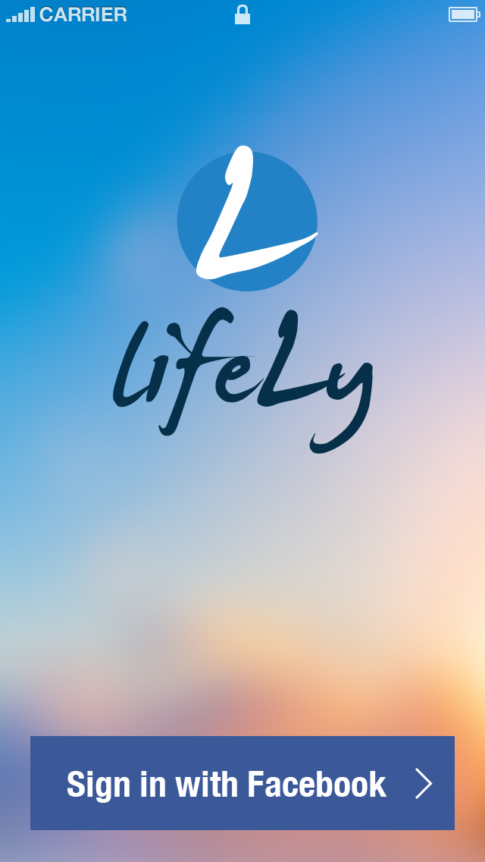

Slide 8
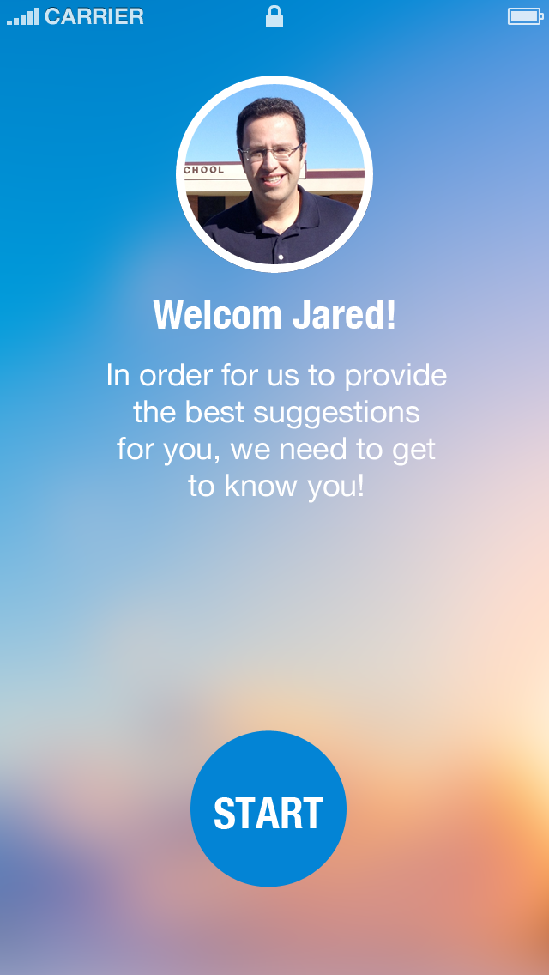
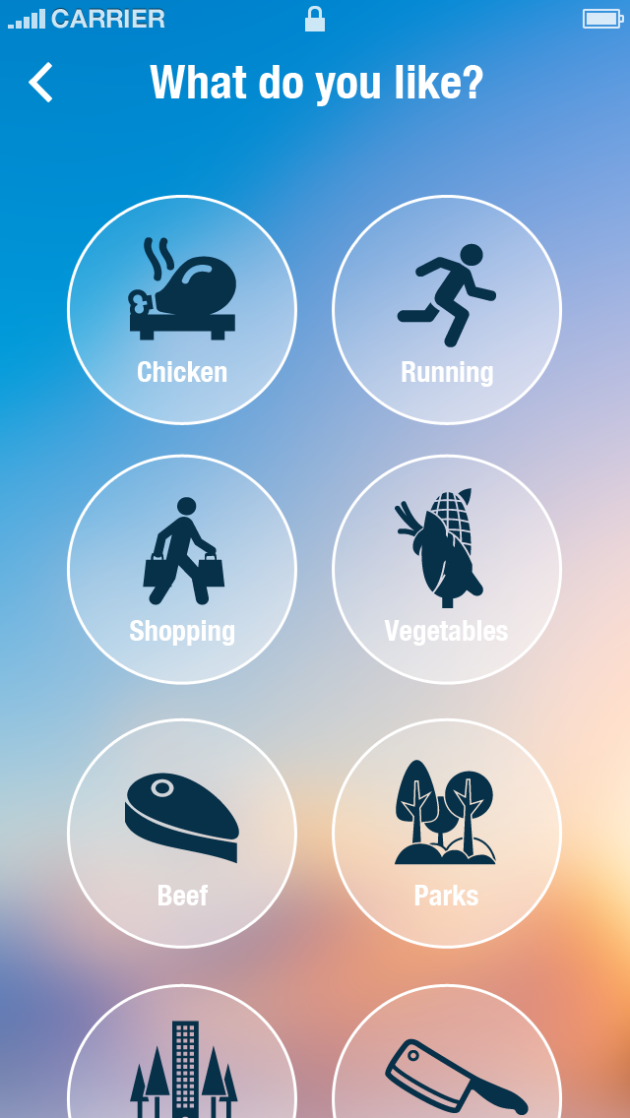

Slide 9
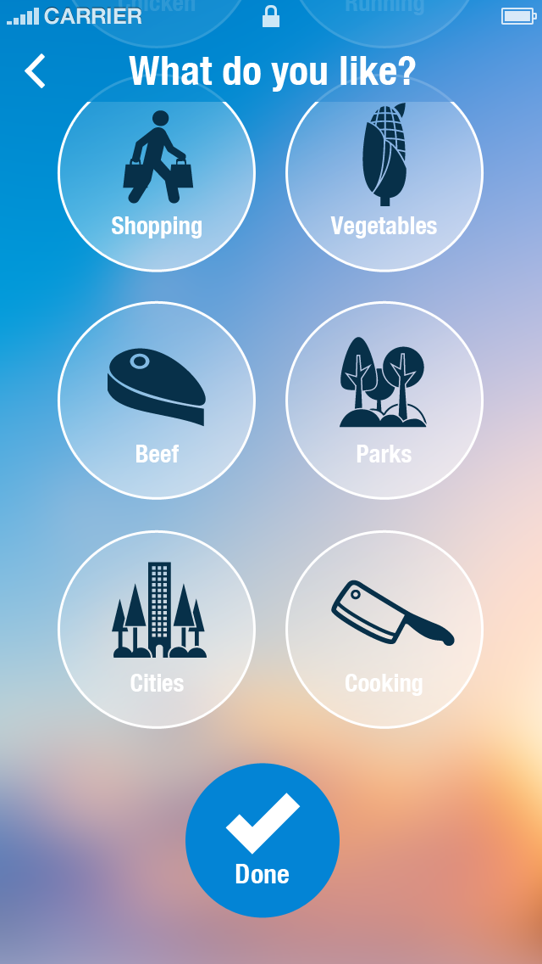
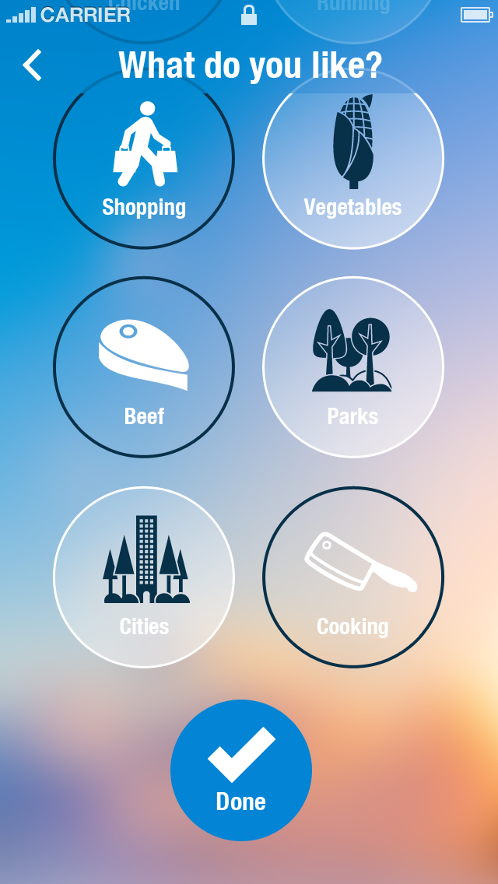

Slide 10

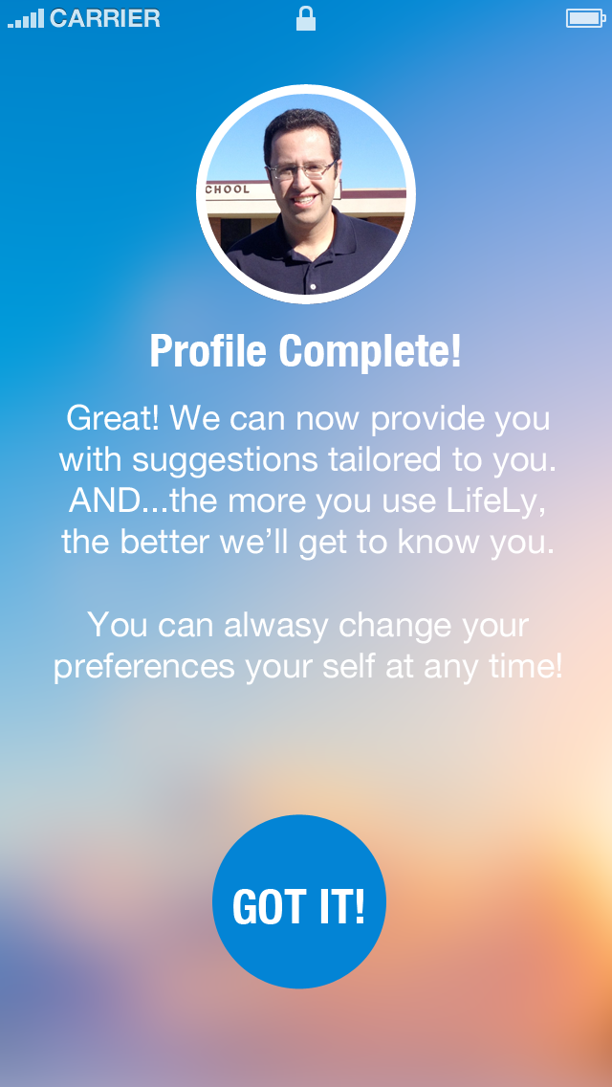

Slide 11
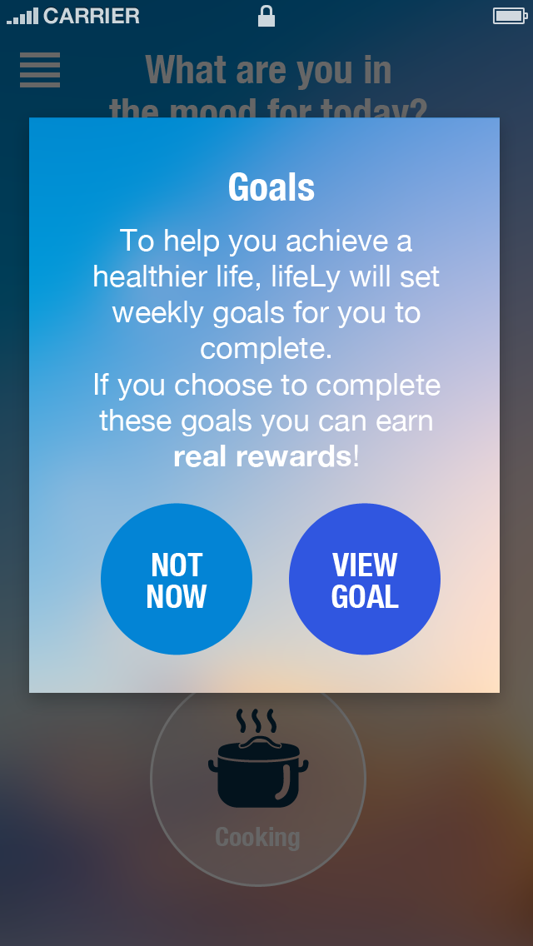
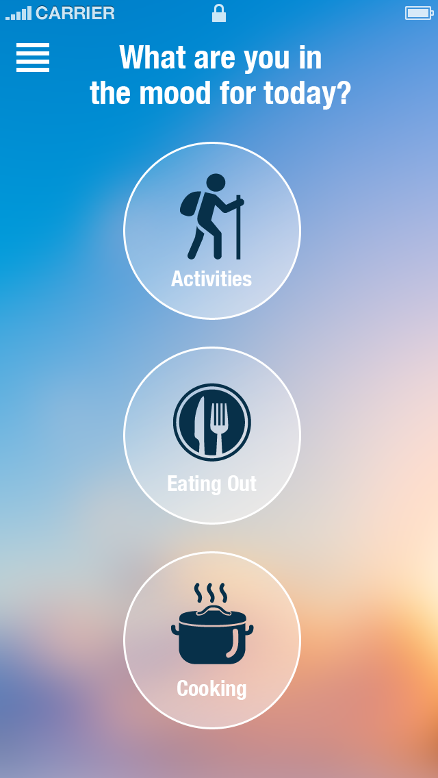

Slide 12
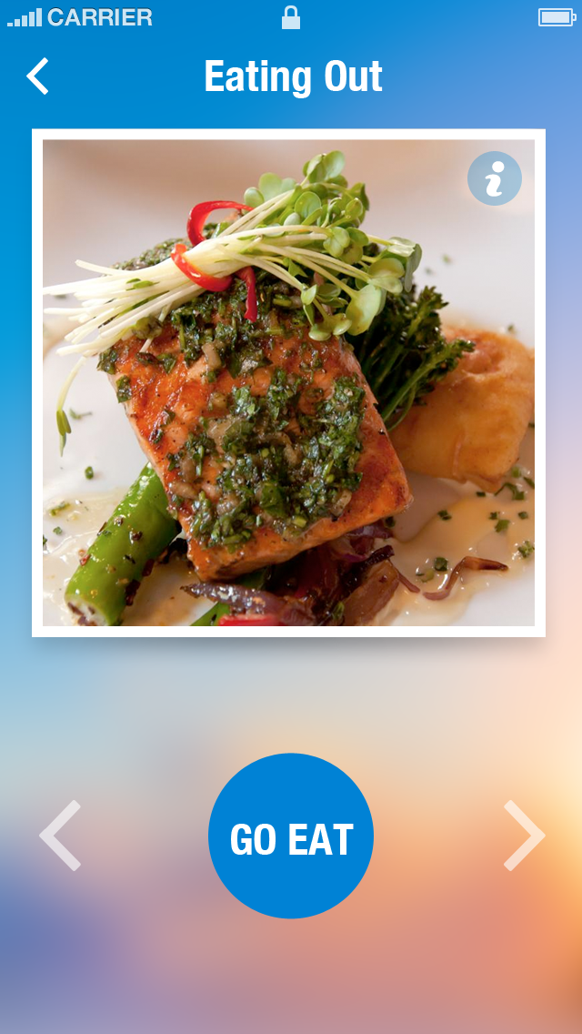
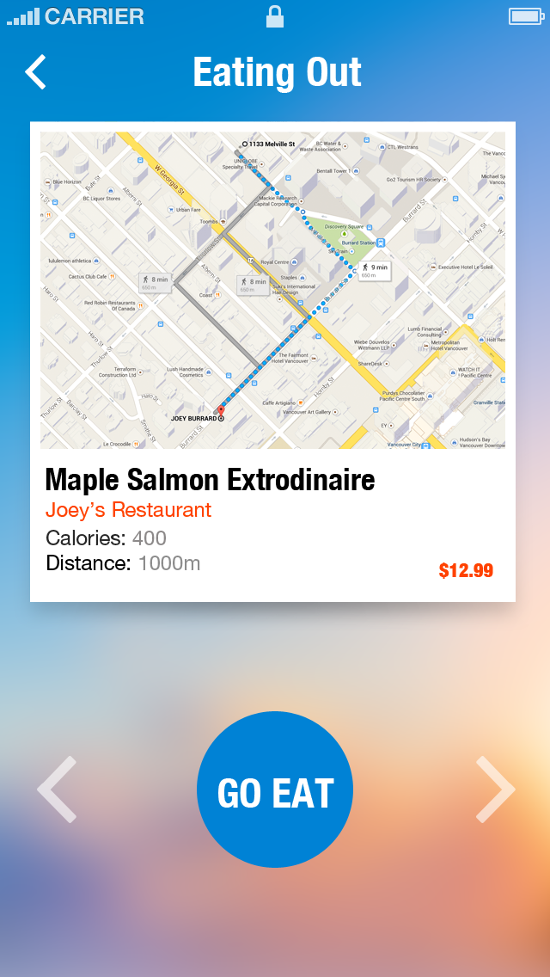

Slide 13
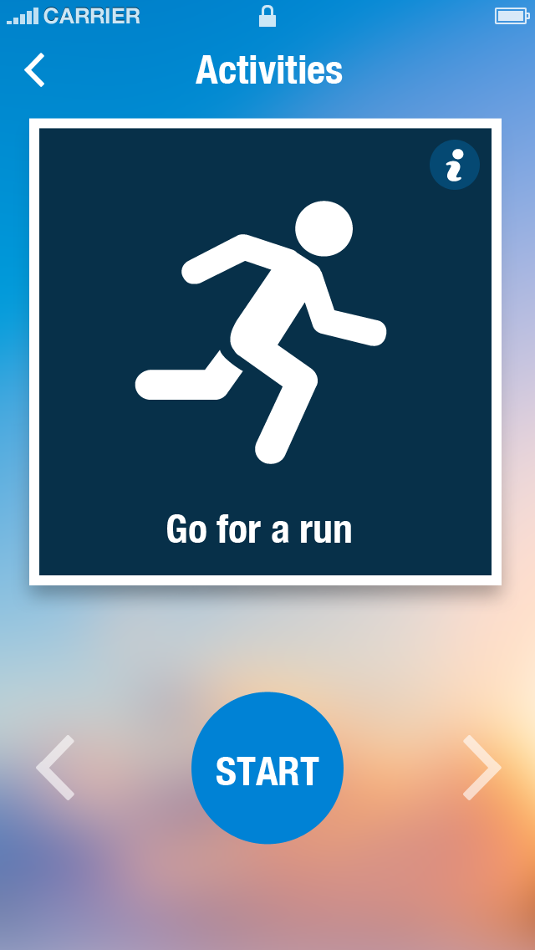

Slide 14
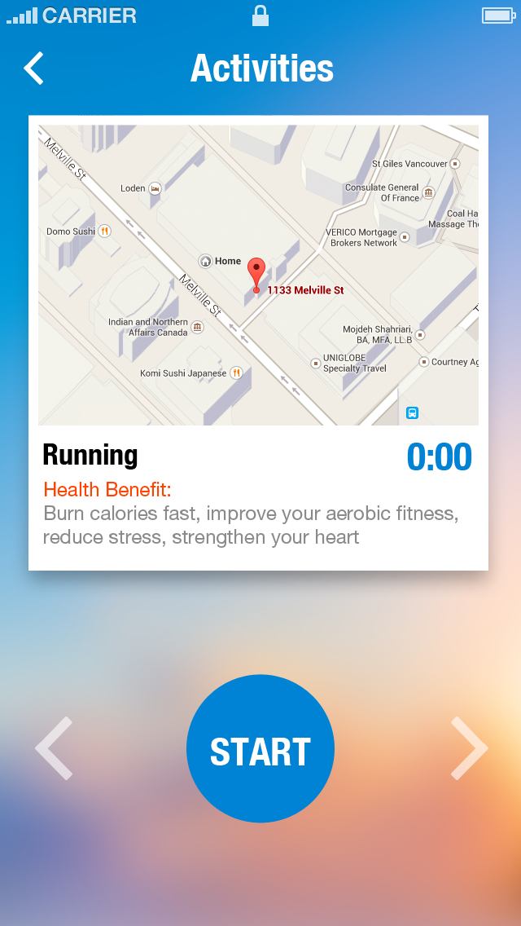
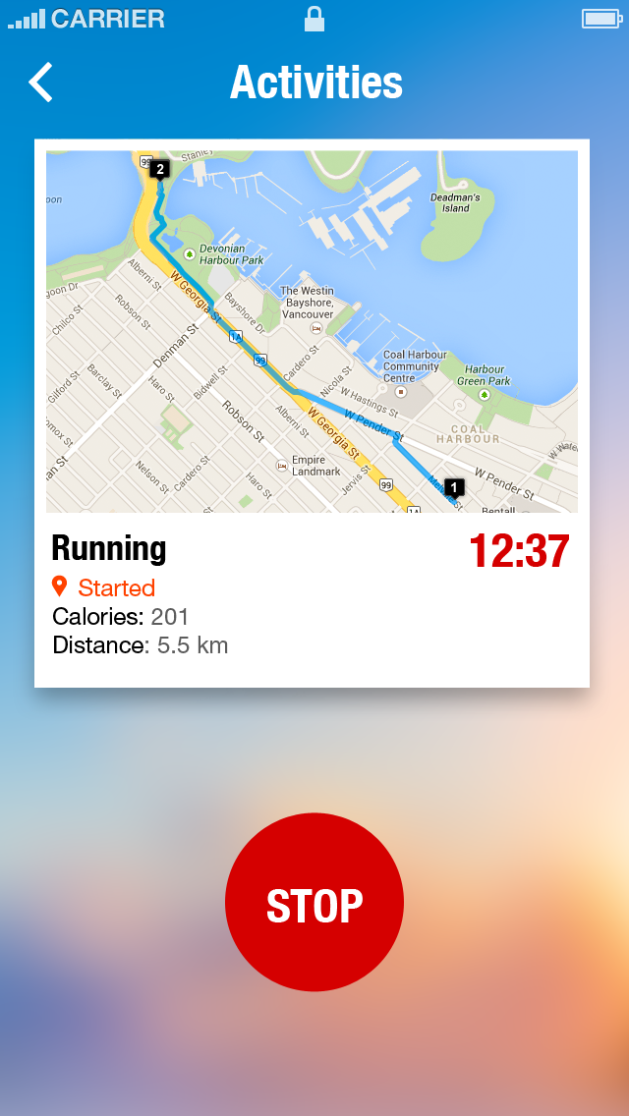

Slide 15
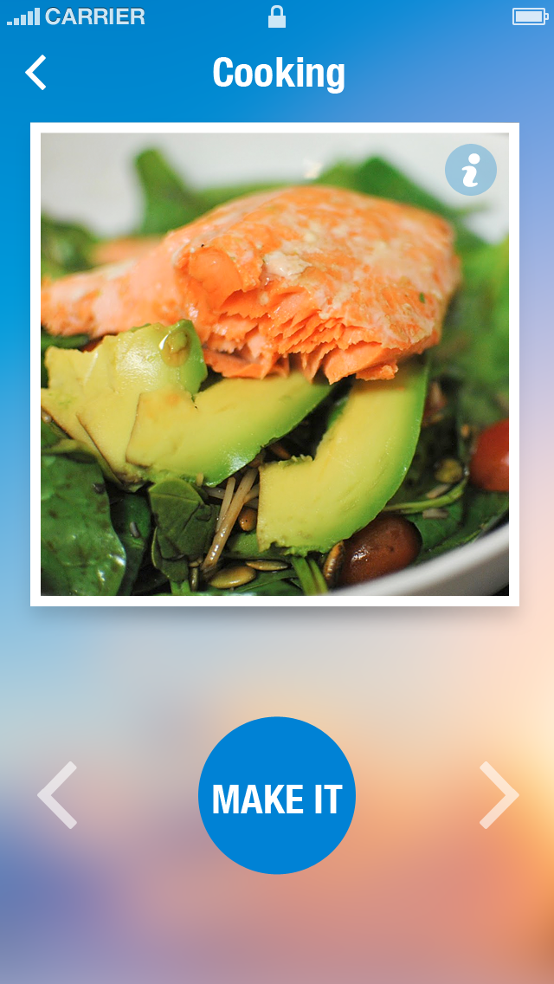

Slide 16
